Slide 1
Renku 2.0
connecting code, data & compute
for FAIR research
Laura Kinkead & Elisabet Capón • 7 Nov 2024

Slide 2
Agenda
1
What is Renku 2.0?
Live Tour
How to stay connected
2
3

Slide 3

Renku is built at the Swiss Data Science Center (SDSC),
a strategic initiative of the ETH domain,
set to become a National Research Infrastructure in 2025.
Our mission is to enable the
Swiss National Open Research Data (ORD) Strategy,
supporting the accessibility and reuse of research data in higher education across Switzerland.
WHO WE ARE

Slide 4
Renku is an open-source platform that
connects the ecosystem of data, code, and compute
to empower researchers to build
collaborative communities.
OUR VISION

Slide 5


Renku 2.0
Connect the research ecosystem
Integrate code repos, data sources, & compute infrastructure.
What’s new
Flexible ‘Plug and Play’ Project Structure
Mix and match code, data, and compute as you need them.

Slide 6






Data Repositories
Code Repository Platforms
EnviDAT
GitLab
Zenodo
ETH Research Collection
GitHub
?
Fileshare
Data Stores
S3 bucket
Laptop
Remote Machine
HPC
Compute Infrastructure

Slide 7

Data Repositories
Code Repository Platforms
EnviDAT
GitLab
Zenodo
SHARE
ETH Research Collection
GitHub
Fileshare
TRACE
Data Stores
S3 bucket
Laptop
Remote Machine
DISCOVER
HPC
Compute Infrastructure

Slide 8
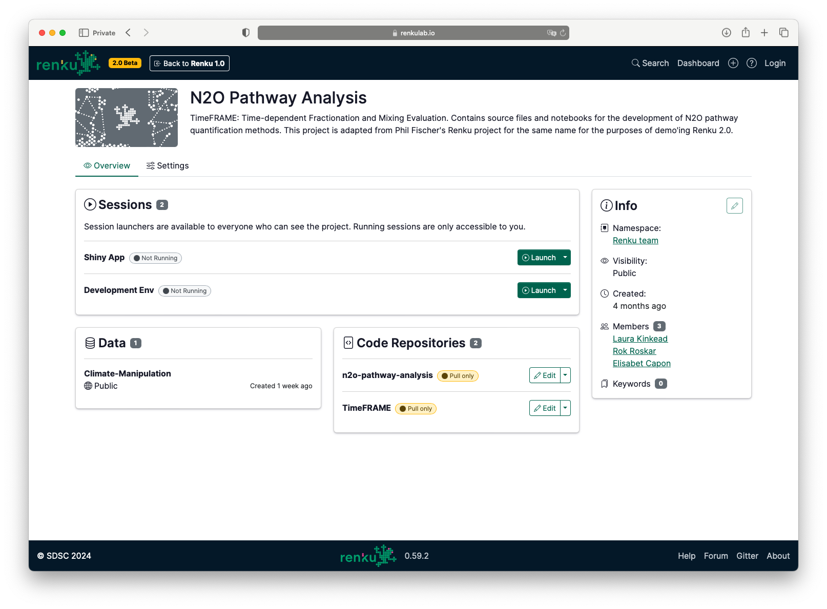

















Renku: Connecting the ORD landscape
Compute
ETH Research Collection
Data
Code

Slide 9


<tour>

Slide 10
Renku 2.0 Launch
Beta Launch
May 2024
Early Access
Winter 2025
Renku 2.0 Launch
Spring 2025

Slide 11
Get more resources & Support the platform
Cost structure:
Fixed infra cost | 4 CHF/user/mo
Fixed platform fee | 10 CHF/user/mo
Resource cost | Depending on need
🚀 More resources for yourself, your group, or your course via Resource Pools
🕵️ Flat, transparent pricing, passing down infra rates savings
🤝 Helps cost-recover and sustain the platform maintenance and development
Example (50 students with 1 cpu/4GB per student):
Fixed infra cost | 200 CHF/mo
Fixed platform fee | 500 CHF/mo
Resource cost | 69.44 CHF/mo
Total | 15.39 CHF/student/mo
*10 hours of usage / student / week

Slide 12



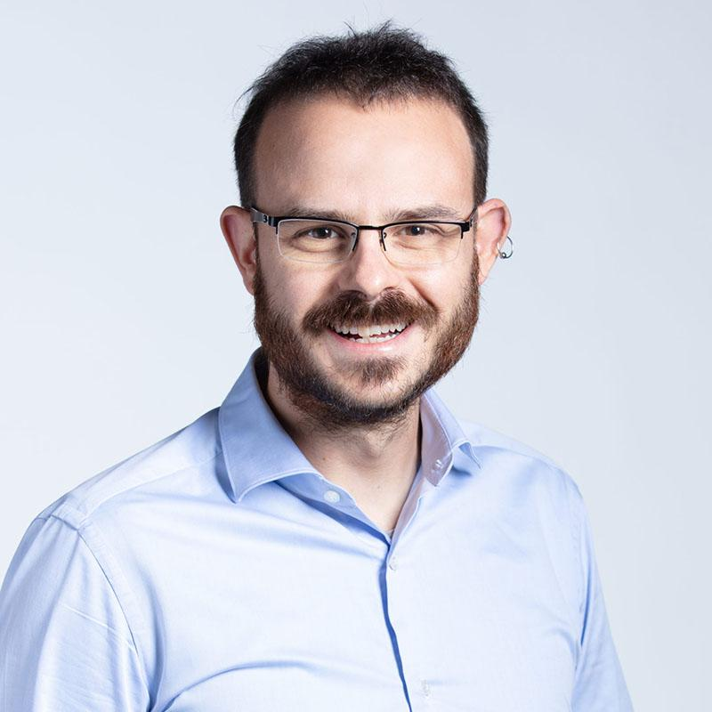



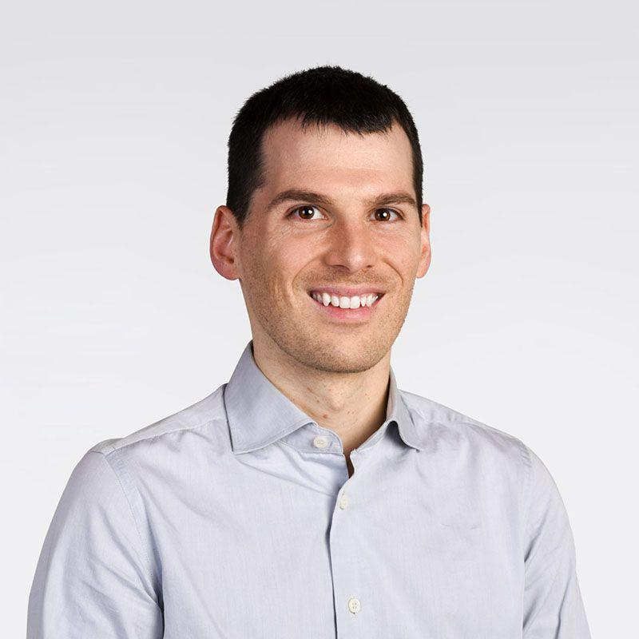





Collaborating with Us
Leadership
Infrastructure & DevOps
Product & Outreach
Rok
Laura
Ralf
Alessandro
Wes
Elisabet
Jimena
Frontend
Backend
External contributors
Lorenzo
Sekhar
Flora
Andrea
Tasko
Mohammad
Eike
Samuel
IDIAP
Salim
IDIAP
Severin
NEXUS

Slide 13
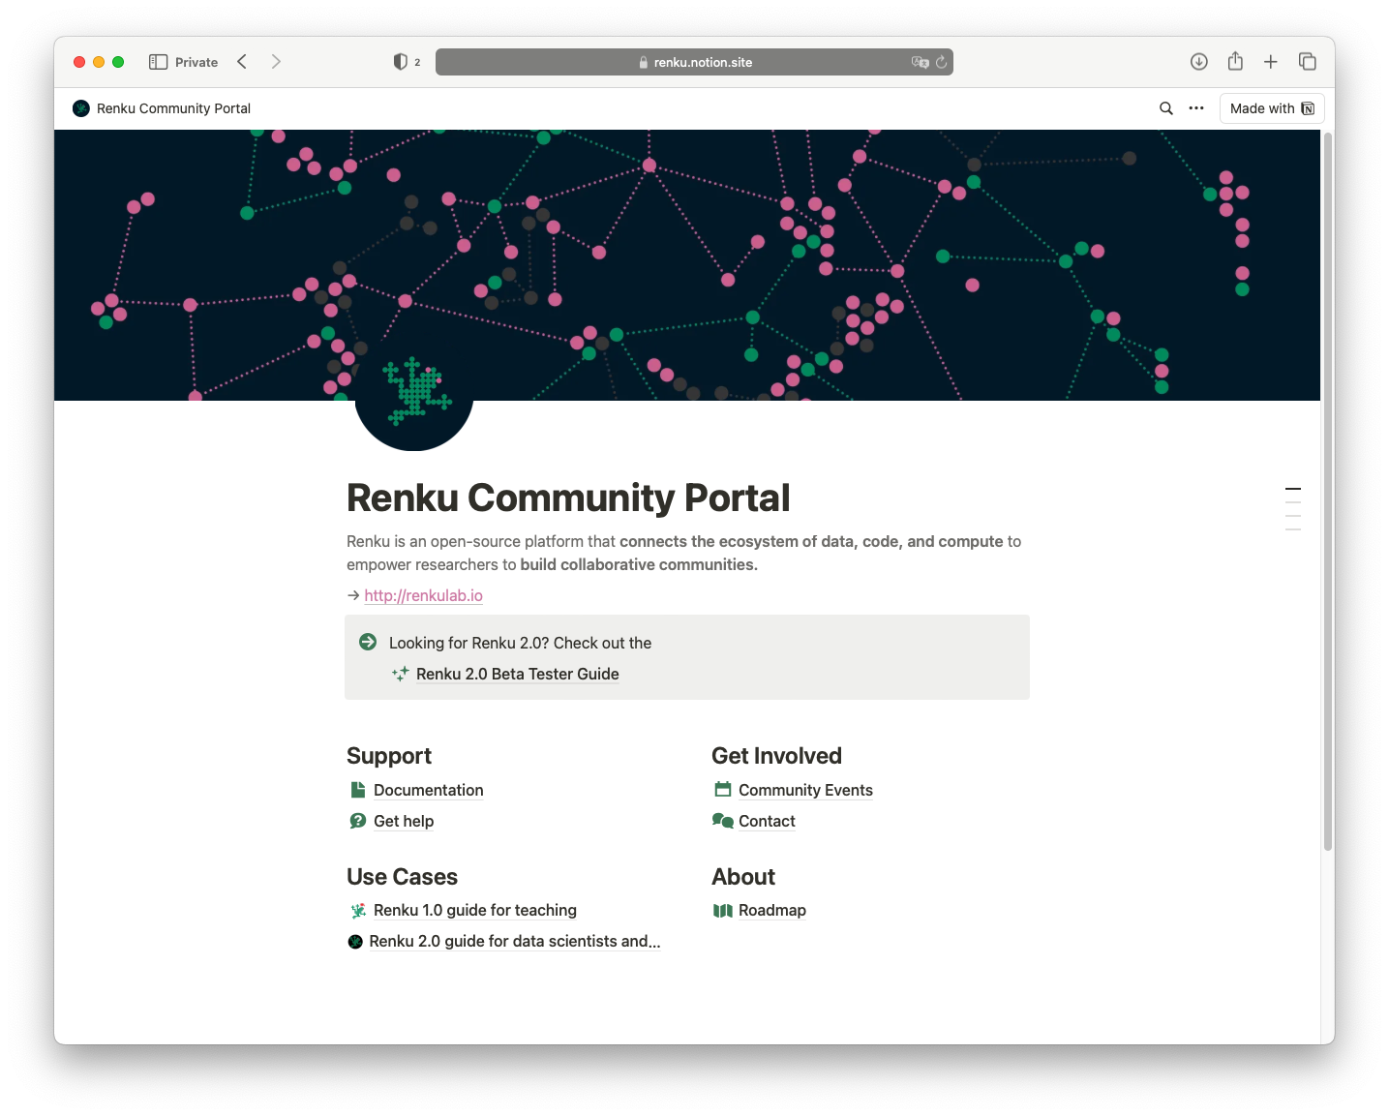
Renku Community Portal
Documentation • Roadmap • Community Events

Slide 14
We want to hear
from you!
https://renkulab.io
💬 Feedback or Feature request?
hello@renku.io
📗 Documentation
🗺️ Check out our Roadmap
🗓️ Attend our Community Events
💻 Need more resources?
Let us know and we can create a resource pool

Slide 15
Appendix

Slide 16






Renku provides multiple capabilities out-of-the-box in an integrated platform
Sign-in | edu-ID, GitHub, ORCID | Validated email | Google account | - | email, google | ETH domain
IDE access | ✅ | ✅ | colab-ssh | ❌ | ✅ | ❌
Manageable environment | ✅ | ✅ | Notebooks | Jupyter, R, Julia | Notebooks | Notebooks
Code version control | ✅ | ✅ | ❌ | ❌ | ❌ | ❌
Integrated cloud storage | ✅ | ❌ | ❌ | ❌ | ❌ | ❌
Compute resources | Free 2 CPU, 8GB, 128GB | Free 2 CPU, 8GB, 15GB storage Up to 60 h/month | Free max run 12h, dynamically adjust limits | Max 2GB RAM. shuts down after 10 min. inactivity | Free 1 CPU, 1GB, 15GB storage Up to 25 h/month | Sessions up to 24 hours. Queue system Euler
Swiss made | 🇨🇭 |  |  |  |  | 🇨🇭
Notes:
Take out live share (real time collaboration as an out-of-the-box) → there are security concerns on accessing to secrets (supplantation of identity)
Without secrets mounted (recommendation). By default only code (Live Share) → TO DO: check if only code or also the root.
Add a new line the infra location
TO DO: take out cloud access line

Slide 17
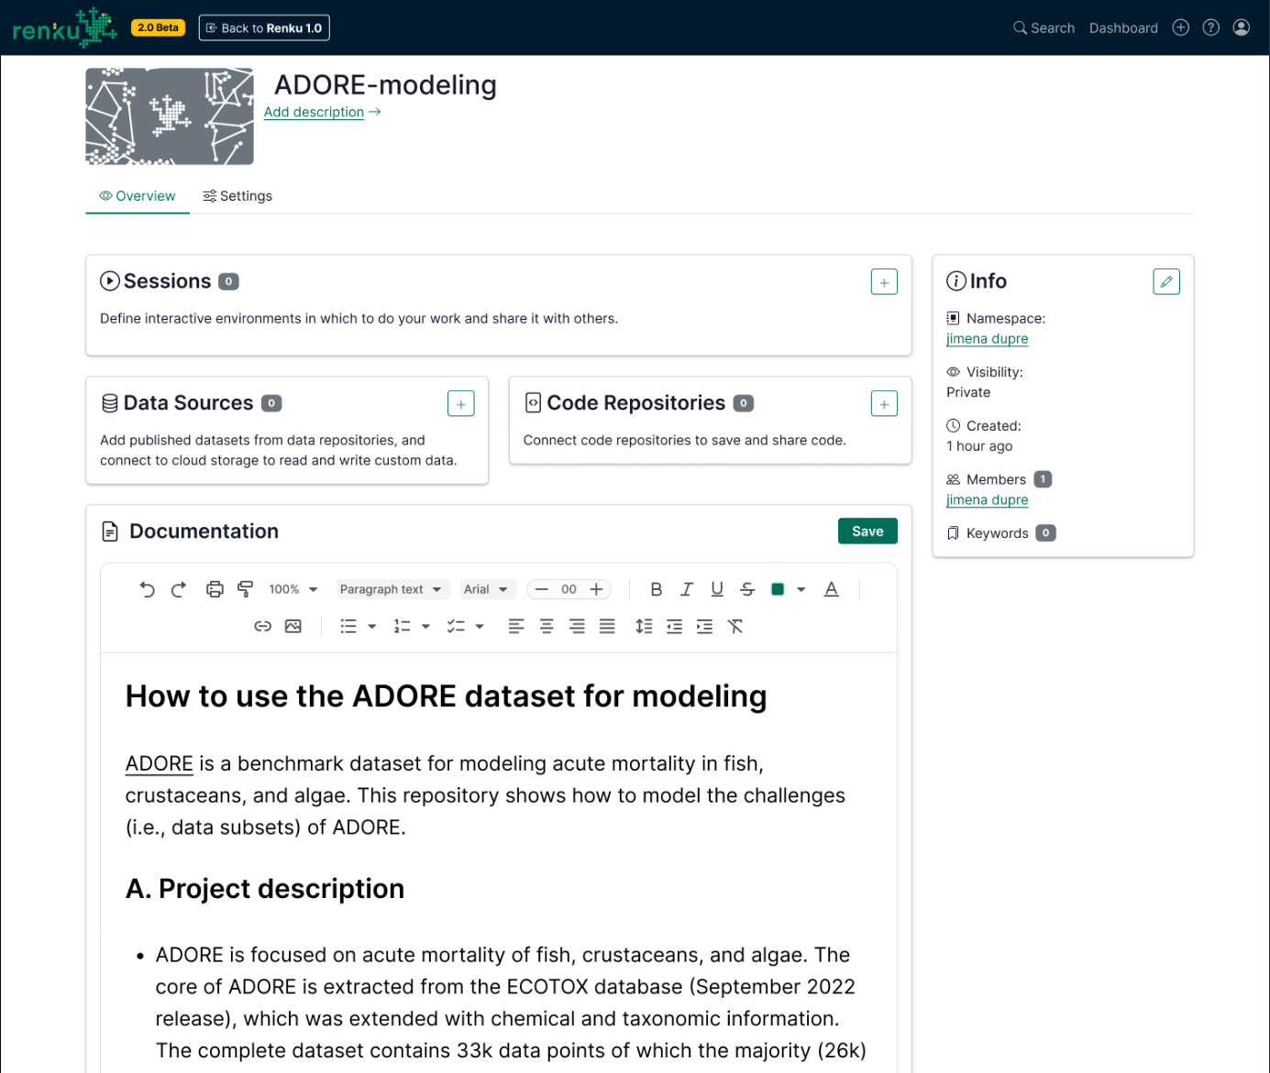
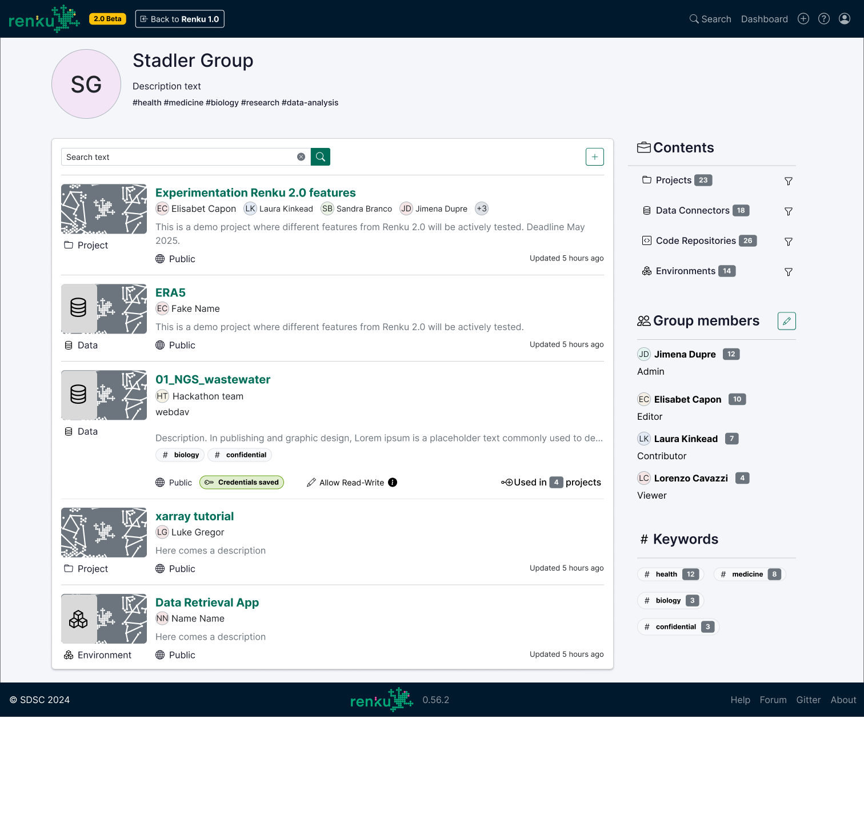
COMING SOON

Slide 18
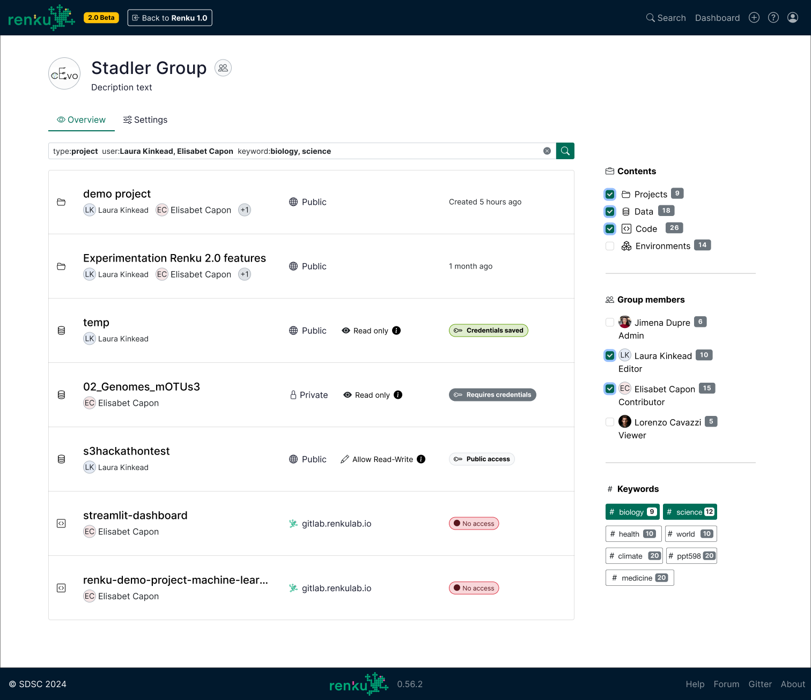
UNDER DESIGN

